Slide 1
Group 1 Final Project
Team Members
Roy Roongseang
Matt Gilliland
Ian Manzano
Sasha Roberts

Slide 2
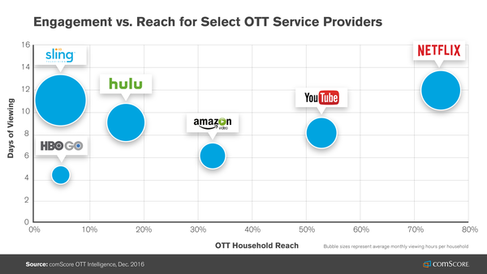
Introduction
Over 1.9 Billion logged-in users visit YouTube each month and every day people watch over a billion hours of video and generate billions of views.
The amount of time Americans spend playing video games and board games has risen by 50 percent since 2003, majority attributed to video games.
Sources: https://www.youtube.com/yt/about/press/
https://www.bls.gov/news.release/pdf/atus.pdf

Slide 3
Executive Summary
YouTube represents one of the world’s largest recommendation engines. Because YouTube’s deep neural networks and algorithms are proprietary, content creators speculate on how to give their videos the best chance at success.
Our objective is to collect valuable data from YouTube’s Data API and outside sources, build a relational database to store that data, and develop reporting and visualization tools for content creators and product owners.
We will focus on particular content vertical (gaming) for the purpose of this project, but our solution will be scalable.

Slide 4
Business Use Case
Top content creators with thousands of videos need to be able to understand:
Which topics perform well by viewership and reception (i.e. sentiment analysis)
How their channel is trending
These insights are also applicable for brand managers who may be interested in how their products, video games, are being discussed and viewed.
This platform could also be used to help businesses choose the right content creator to partner with and showcase their product.

Slide 5
Constraints
On Feb 6th Google limited the number of queries in a day from 1 million to 10,000.
One account is able to pull 50,000 video ids, 2,000 video statistics, 150,000 comments or some combination per day.
This required extra coordination between team members to maximize size of data set available for analysis.
Youtube Data API is geared towards users accessing their own channels and interacting with Youtube’s site.
No direct call to get all video ids for a channel.
Channel Ids were sourced from a 3rd party website.

Slide 6


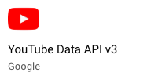



Data processing pipeline
Socialblade.com
3rd party website
Sentiment Analysis
Excel
Python API
Data Source
Data Processing
Data Warehouse
Analytics & Dashboard

Slide 7
Data – Youtube API
API Requests
Queries
JSON
Youtube.channels().list
Youtube.playlistItems().list
Youtube.videos().list
Youtube.commentThreads().list
contentdetails
snippet
statistics

Slide 8
Design Considerations - Platform
Utilized python to extract data from Youtube Data API V3, and compiled it into data tables for our relational database.
Aim of the project is to analyze video data to help content creators and sponsors see what variables contribute to viewership. With this in mind, the following tables were created.
Video: list of videos published by a content creator
Fact_table: associated statistics such as views, likes/dislikes, etc.
Tags: keywords tied to videos which help viewers locate related videos
Youtube channel ids and video ids are unique and set as primary keys. Other keys like comments and unique tags have generated keys.

Slide 9
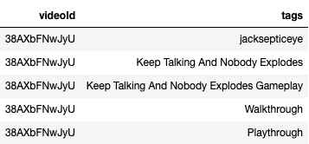
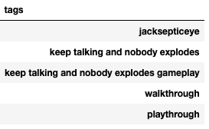

Design Considerations – Data Prep
String of tags normalized into unique tags and unique combination of tags and videos
Flagged sponsored videos

Slide 10

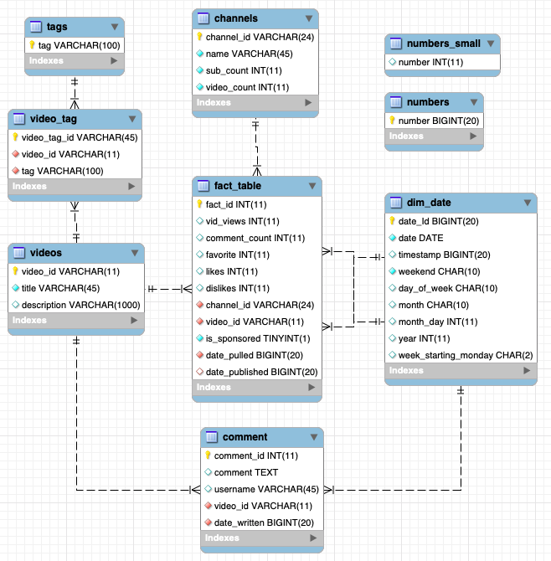
Enhanced Entity Relationship Snowflake Model

Slide 11
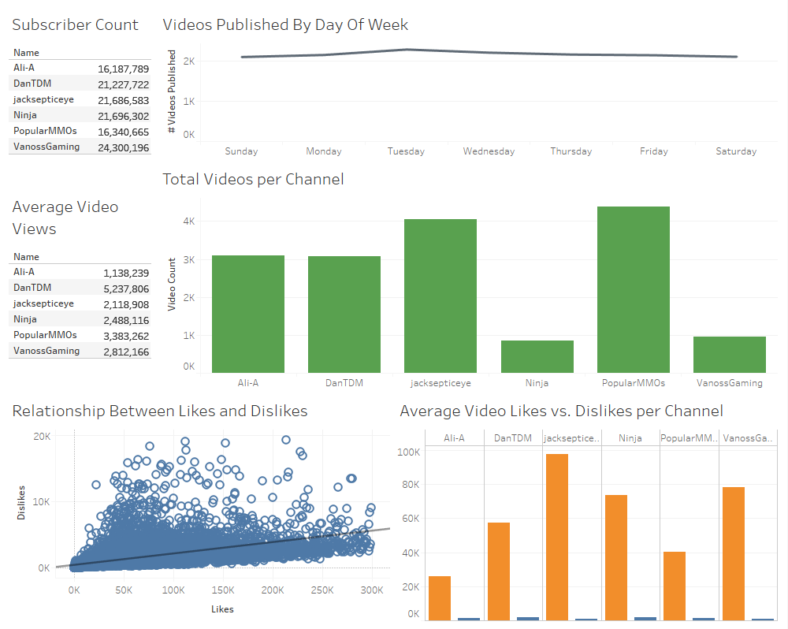

Slide 12
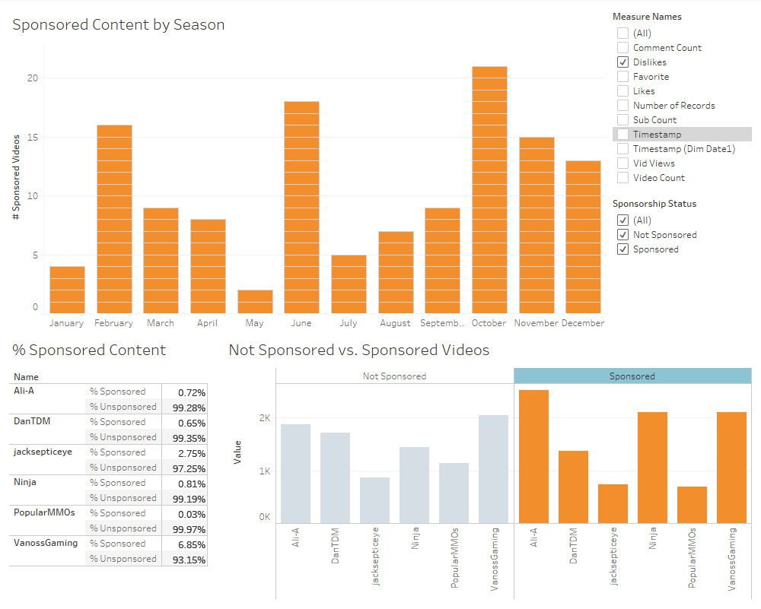

Slide 13
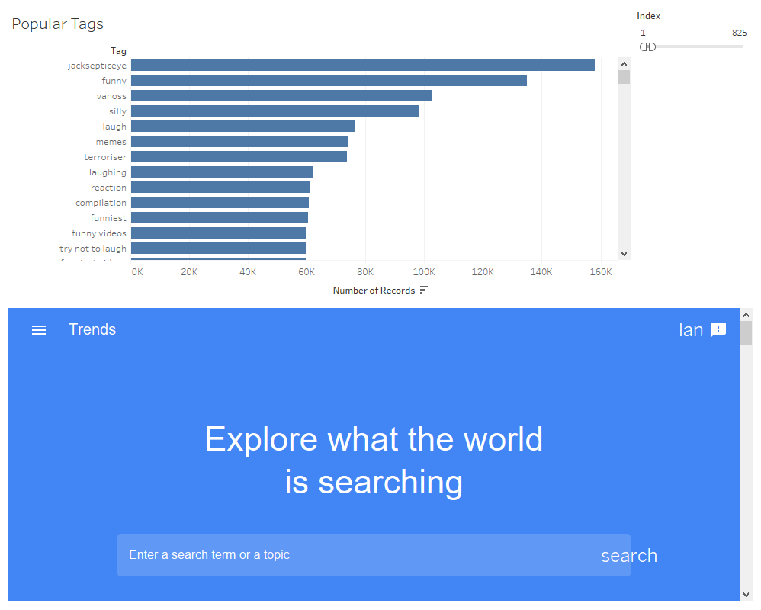

Slide 14
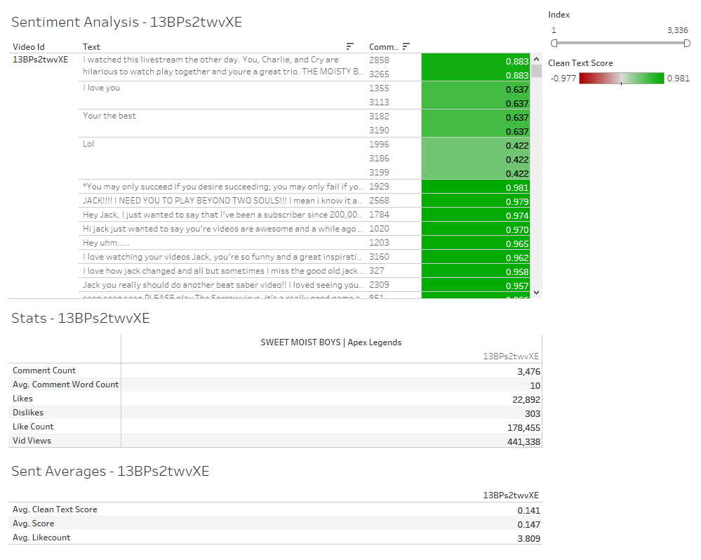

Slide 15
Sentiment Analysis
Pulled data directly from YouTube’s API for a specific video.
Assigned comment score using NLTK (Natural Language Toolkit).
Specifically, we used VADER library because this is social media data.
Cleaned text by removing contractions and assigned “clean text” score.
Filtered “clean text” compound polarity scores in Tableau.
Combined video statistics from database and filtered scores in a single dashboard.

Slide 16
Recommendations
If you have Youtube aspirations and want to start a gaming channel
Upload videos on Saturdays
Most popular topics (based on tags) are …
Sponsored videos
Understand the types of videos a channel publishes and don’t try to push content that don’t match.
Don’t assume a sponsored content will get the same level of viewership as regularly published videos.

Slide 17
Future Considerations
Incorporate a scheduler for daily data pulls
Web scrape top subscribed channels
Automate data load into data warehouse and push into dashboard
Extract video length for analysis

